Slide 1
SQL Server Extended Events
What have you been waiting for?

Slide 2
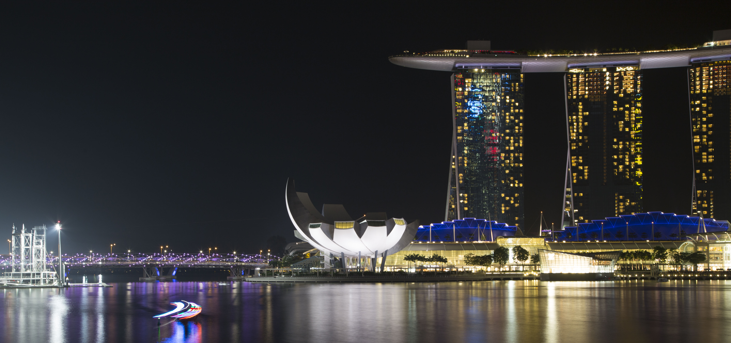





PowerShell Conference Asia
SQL Server Extended Events
What have you been waiting for?
Photos of Marina Bay Credit: Sebastian Szumigalski

Slide 3

Don’t Forget!
Fill in your survey in Mobile app – it’s how we do better!
Don’t lose your badge! You need it for the Social Events
Grab the Speakers for a chat – they all have time for you!
Let everyone know what they are missing on Social Media
#PowerShell #PSConfAsia
Photos of Marina Bay Credit: Sebastian Szumigalski
PowerShell Conference
Singapore 2017

Slide 4
PowerShell Conference
Singapore 2017

Slide 5
PowerShell Conference
Singapore 2017

Slide 6
The Man
Work
SQL Server DBA since last century
Microsoft UK Data and AI Premier Field Engineer
Community
User group leader / speaker
SQLBits committee member
SQL Saturday organiser / speaker
Hobby
Restoring classic VW Golf
PowerShell Conference
Singapore 2017
Notes:
15 years as full time DBA until starting with Microsoft. Used SQL since 6.5/7
UG since 2010
SQLRelay
SQL Saturdays
SQLBits

Slide 7
The Plan
The What, Why and How of Extended Events
Demos
Questions
PowerShell Conference
Singapore 2017
Notes:
First of all a look at what Extended Events are, Why we should be using them rather than other options and then How we go about it.
Plenty of demos
Questions – don’t wait to ask. Call out when you want to know something

Slide 8
The What
Lightweight
Event based
Fully featured
PowerShell Conference
Singapore 2017
Notes:
Extended Events are part of SQL Server since SQL Server 2008. They are like break points in the sqlservr.exe code that we can watch and take action if that event happens.
Micro-seconds to execute
Easily filtered and focussed on the activities that we want
Have the option to collect other relevant information that we need
Options for storage and reviewing beyond the .trc file and database table that Profiler offers

Slide 9
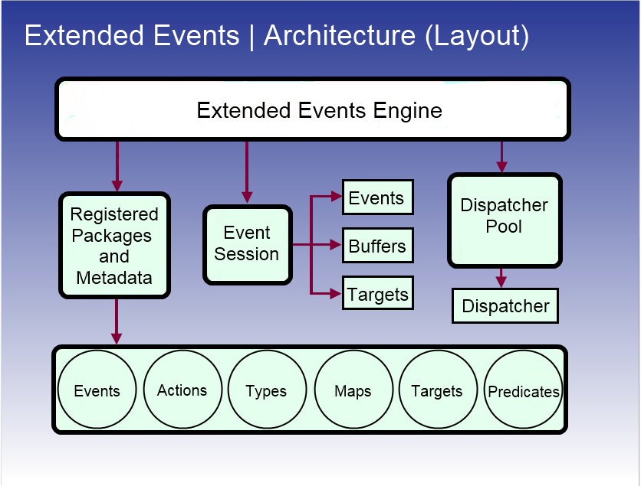
(Image recreated by Jonathan Allen from MSDN/Books online)

Slide 10
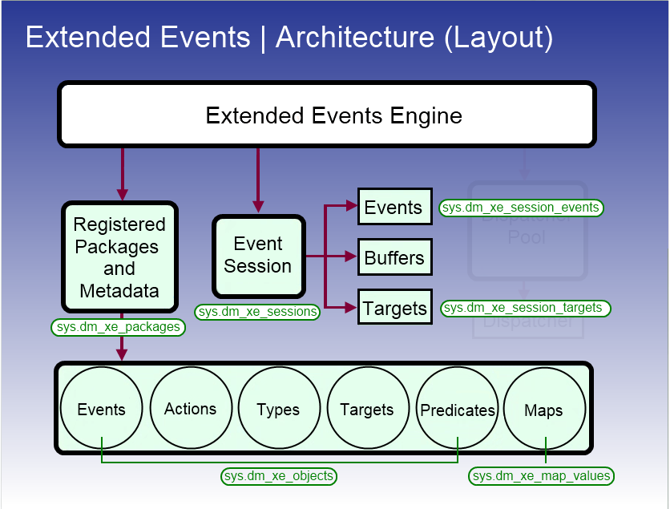
(Image recreated by Jonathan Allen from MSDN/Books online)

Slide 11
The Why
SQL Profiler is deprecated
Low server impact
PowerShell Conference
Singapore 2017
Notes:
SQL Profiler is on the deprecated features list since 2008 so we should not be basing new activities on it.
SQL Profiler was / is likely to have a measurable impact on server performance. Even when using a ‘server side’ trace.

Slide 12
The How
SSMS
TSQL
PowerShell
PowerShell Conference
Singapore 2017
Notes:
SSMS from SQL 2012 allows for GUI interaction with XE.
TSQL (obtained from Script as… function) will work on all versions, dependant on selected events etc
PowerShell dependent on version will allow XE session admin

Slide 13
Demos
PowerShell Conference
Singapore 2017
Notes:
First a run through SSMS and a review of what XE are, how they are used and administered.
Then a trip into Powershell to see how things work from there and then a little bit of Pester to make sure that things are as they should be.

Slide 14
Recommendations
Consider
Target – Sync or Async
Storage – type, size
Retention – No_Event_Loss or Allow_Single_Event_Loss/Allow_multiple_Event_Loss
Use SSMS 2012 or later to build session, save script, adjust and apply to 2008
PowerShell Conference
Singapore 2017

Slide 15
Summary
What Extended Events are
How they work and what they can offer you
How to create an XE session that will be useful for server administration
PowerShell Conference
Singapore 2017

Slide 16
Summary
How to customise XE sessions
How to manage and propagate XE sessions with PowerShell
How to use PowerShell and Pester to give you confidence in your SQL Server performance and configuration.
PowerShell Conference
Singapore 2017

Slide 17
References
Jonathan Kehayias
http://twitter.com/#!/sqlpoolboy / http://www.sqlskills.com
http://extendedeventmanager.codeplex.com/
http://sqlblog.com/blogs/jonathan_kehayias/archive/2010/12.aspx
MVP Deep Dives 1
Chapter 49 by Christian Lefter – via Amazon among other book sellers
SQL Server 2008 Internals and Troubleshooting
(Bolton, Langford, Ozar, Rowland-jones, Wort) via Amazon among other book sellers
Adam Machanic – blog (code generator/tips+advice)
http://sqlblog.com/blogs/adam_machanic/archive/tags/extended+events/default.aspx
PowerShell Conference
Singapore 2017

Slide 18
References
SQL 2012 SSRS performance reports
http://www.microsoft.com/download/en/details.aspx?id=29063
Books Online
2008 - http://msdn.microsoft.com/en-us/library/bb677357(v=SQL.100).aspx
2012 - http://msdn.microsoft.com/en-us/library/ms130214(v=sql.110).aspx
MSDN Convert Trace to XE article
http://msdn.microsoft.com/en-us/library/ff878114(v=sql.110).aspx
Microsoft Docs – Extended Events
https://docs.microsoft.com/en-us/sql/relational-databases/extended-events/extended-events
PowerShell Conference
Singapore 2017

Slide 19
Contact info
Twitter: @fatherjack
Email: jonathan@sqlsouthwest.co.uk
Blog: https://blogs.technet.microsoft.com/dataplatform/
PowerShell Conference
Singapore 2017

Slide 20
Don’t Forget!
Fill in your survey in Mobile app – it’s how we do better!
Don’t lose your badge! You need it for the Social Events
Grab the Speakers for a chat – they all have time for you!
Let everyone know what they are missing on Social Media
#PowerShell #PSConfAsia
Photos of Marina Bay Credit: Sebastian Szumigalski
PowerShell Conference
Singapore 2017

